Slide 1


Data Platforms - Cloud
mintesnot

Slide 2
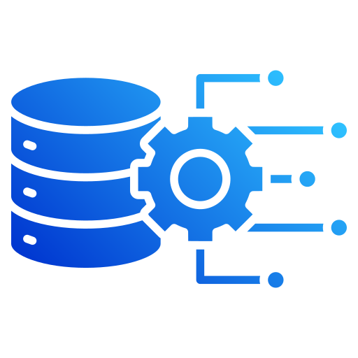
What is Cloud Data Platform?
Components of Cloud Data Platform
The Cloud Data Landscape
What is a Data Warehouse?
ETL
ELT
ETL Vs. ELT

Slide 3
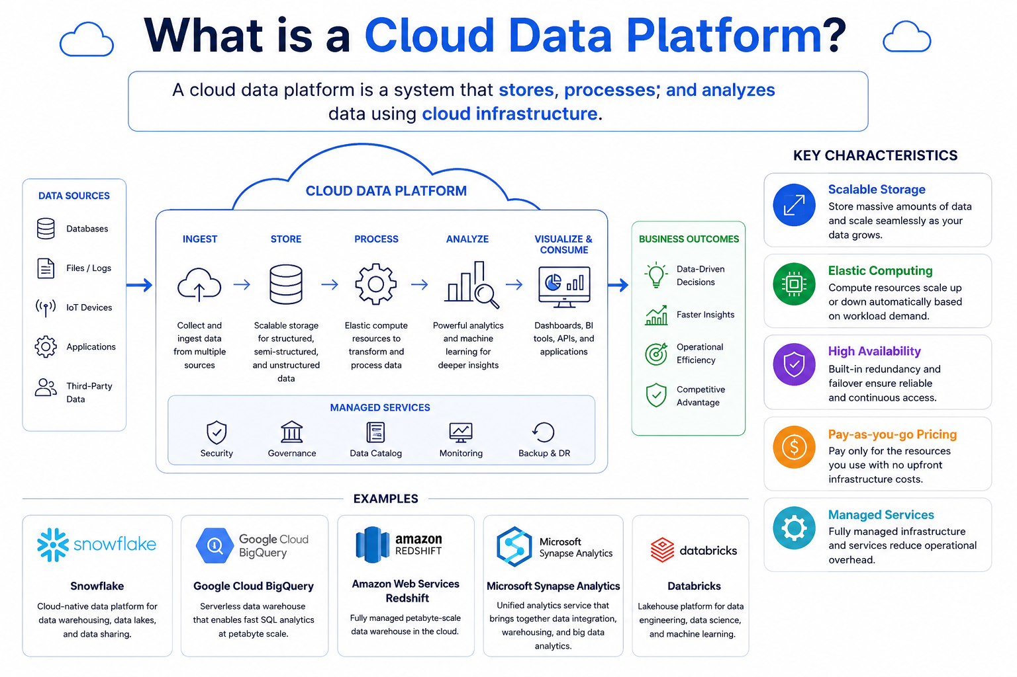


What is a Cloud Data Platform?
A Cloud Data Platform is a system that stores, processes, and analyzes data using cloud infrastructure.
Key Characteristics
Scalable storage
Elastic computing
High availability
Pay-as-you-go pricing
Managed services
Examples
Snowflake
Google Cloud BigQuery
Amazon Web Services Redshift
Microsoft Synapse Analytics
Databricks

Slide 4

Traditional Vs. Cloud Data Platforms
Traditional | Cloud
On-premise servers | Cloud infrastructure
High upfront cost | Pay-as-you-use
Limited scalability | Near unlimited scalability
Manual maintenance | Managed services
Slow provisioning | Rapid deployment
Benefits of Cloud: Faster innovation , Reduced infrastructure management ,Better performance & Global accessibility

Slide 5
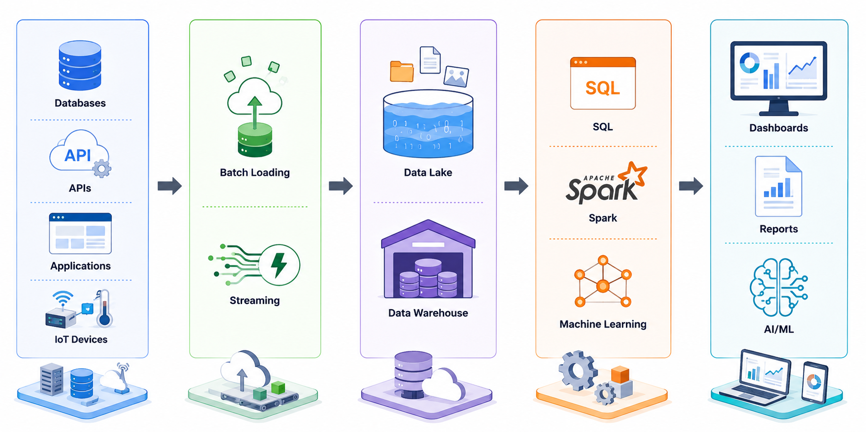
Components of a Cloud Data Platform

Slide 6

What is a Data Warehouse?
A data warehouse is a centralized repository designed to store integrated and historical business data.
It is optimized for reporting, analytics, and decision-making rather than daily transactions.
It combines data form multiple source systems into a single source of truth.
Purpose
Support business intelligence.
Enable historical analysis.
Improve reporting accuracy.
Facilitate strategic decision-making.

Slide 7

Characteristics of a Data Warehouse
Subject-Oriented
Data is organized around business subjects such as sales, customers, and products.
Integrated
Data from multiple systems is standardized and consolidated.
Time-Variant
Historical data is retained for trend analysis and forecasting.
Non-Volatile
Data is primarily read-only and is not frequently updated after loading.

Slide 8

OLTP Vs. OLAP
OLTP | OLAP
Supports daily transactions | Supports business
Optimized for inserts & updates | Optimized for complex queries
Current operational data | Historical analytical data
Used by operational users | Used by analysts and managers
Examples
OLTP: Online banking, e-commerce orders.
OLAP: Sales dashboards, executive reports.

Slide 9
The Cloud Data Landscape (Major Players)
Platform/Vendor | Primary Strengths | Ideal Use Case
Snowflake | Multi-cloud, near-zero management, exceptional data sharing capabilities. | Organizations wanting a powerful, user-friendly, SaaS data warehouse across different clouds.
Google BigQuery | Serverless architecture, built-in ML, lightning-fast performance on massive datasets. | Data-heavy organizations heavily integrated into the Google ecosystem.
Cloud platforms generally fall into two categories: cloud-native standalone platforms and cloud provider ecosystems.

Slide 10
…
Platform/Vendor | Primary Strengths | Ideal Use Case
Amazon Redshift | Deep integration with AWS ecosystem, highly customizable, cost-effective at scale. | AWS-centric enterprises requiring tight integration with S3 and EC2.
Databricks | Unifies data lakes and data warehouses (Lakehouse), dominant in AI/Machine Learning. | Advanced analytics teams, data scientists, and complex engineering pipelines.

Slide 11
What is ETL?
ETL = Extract → Transform → Load
Process
Extract data from source systems.
Transform the data before loading.
Load the transformed data into the warehouse.
Characteristics
Data quality checks occur before loading.
Common in traditional data warehouse environments.
Requires separate transformation infrastructure.

Slide 12
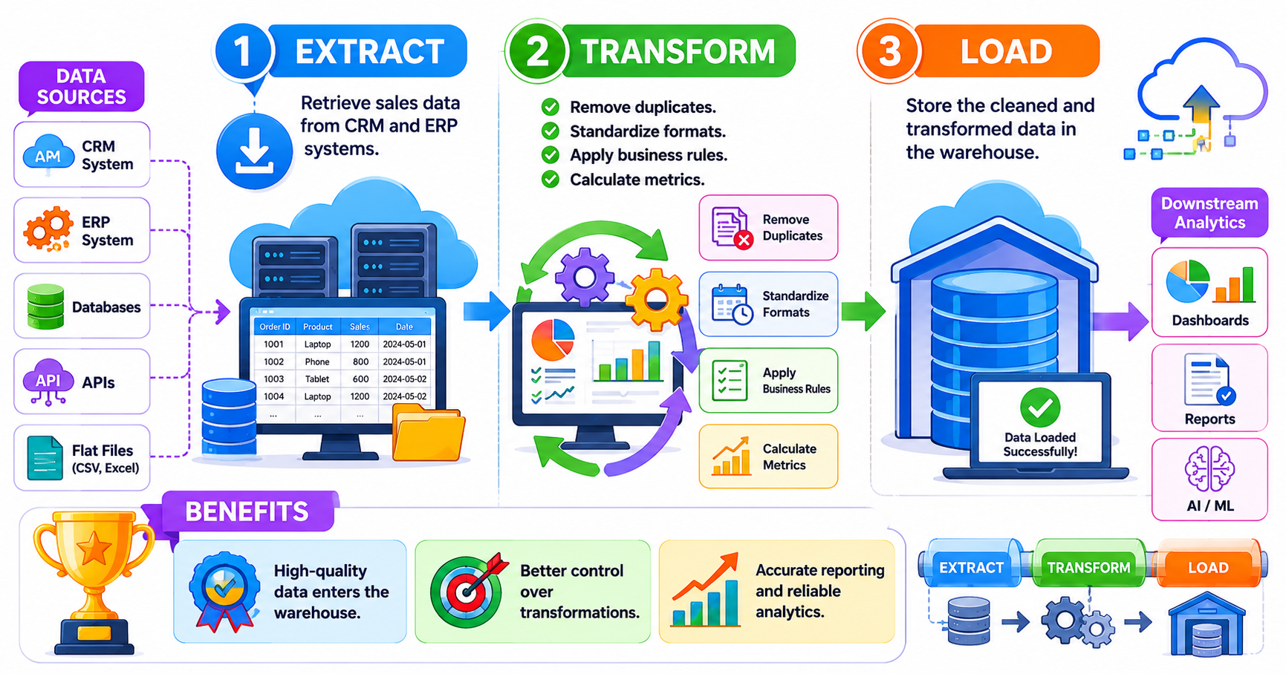
ETL Workflow Example
Extract
Retrieve sales data from CRM and ERP systems.
Transform
Remove duplicates.
Standardize formats.
Apply business rules.
Calculate metrics.
Load
Store the cleaned and transformed data in the warehouse.
Benefits
High-quality data enters the warehouse.
Better control over transformations.

Slide 13
What is ELT?
ELT = Extract → Load → Transform
Process
Extract data from source systems.
Load raw data directly into the warehouse.
Transform data inside the warehouse.
Characteristics
Takes advantage of cloud computing power.
Stores raw and historical data.
Supports flexible analytics.

Slide 14
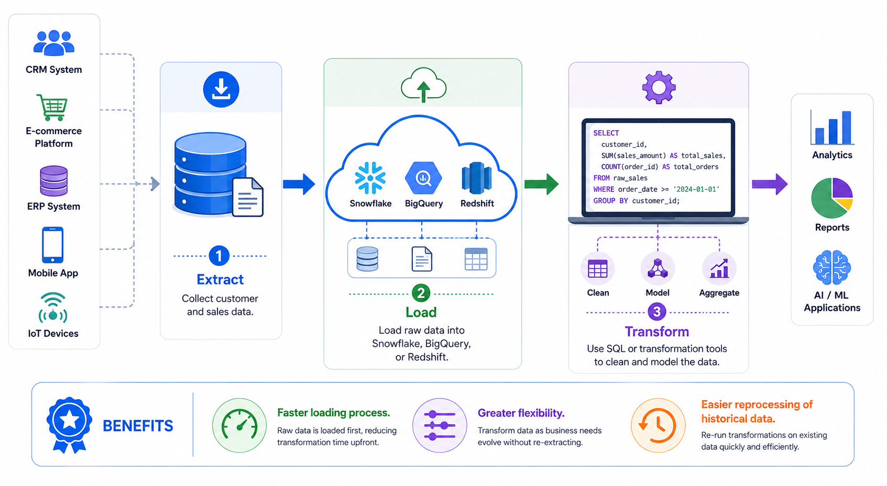
ETL Workflow Example
Extract
Retrieve sales data from CRM and ERP systems.
Transform
Remove duplicates.
Standardize formats.
Apply business rules.
Calculate metrics.
Load
Store the cleaned and transformed data in the warehouse.
Benefits
High-quality data enters the warehouse.
Better control over transformations.

Slide 15
ETL Vs. ELT
Feature | ETL | ELT
Transformation | Before loading | After loading
Processing Location | External server | Data warehouse
Raw Data Storage | Usually not stored | Stored
Scalability | Limited | High
Cloud-friendly | Moderate | Excellent
Big Data Support | Moderate | Excellent
Flexibility | Lower | Higher

Slide 16
Key Takeaways
Cloud Data Platforms
Provide scalable and cost-effective data infrastructure.
Support modern analytics, BI, and machine learning workloads.
Data Warehousing
Centralizes business data for analysis.
Uses fact and dimension tables for reporting.
ETL Vs. ELT
ETL transforms data before loading.
ELT transforms data after loading.
ELT is the preferred approach for modern cloud-based architectures.

